Slide 1
Genetic Cars
CS 461
Austin Bennett 324855

Slide 2
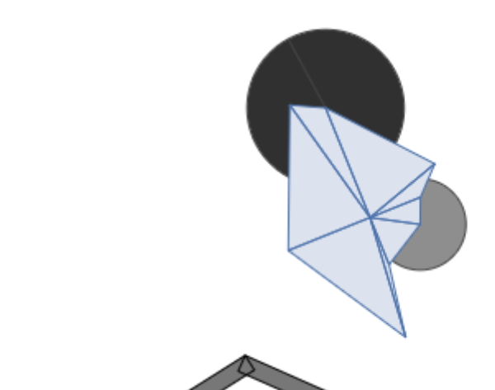
Initial Top Car
Large front wheel
  Able to get over most bumps
Fast
  Let it float over larger gaps

Slide 3

20 Generations
This car was able to flip itself over when it got stuck
It still had a large amount of speed and a larger front wheel

Slide 4
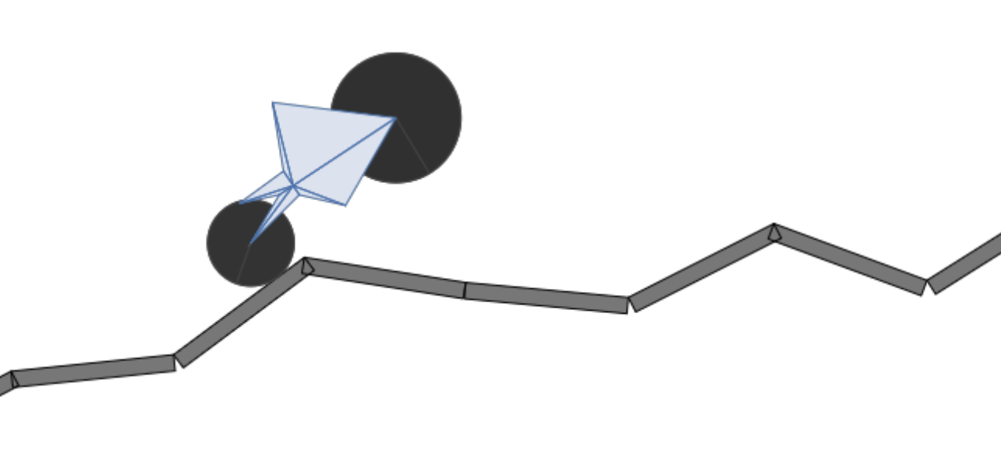
40 Generations
Let’s mix this up

Slide 5
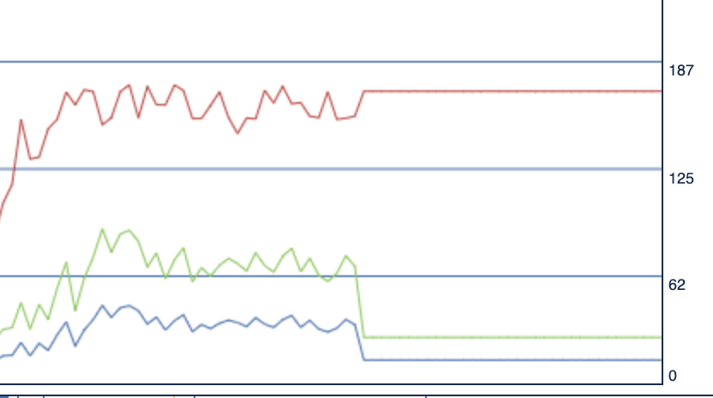
Mutation Rate
Crank it to the max
What happened here?
The top car would always when
The other cars didn’t have any shot

Slide 6
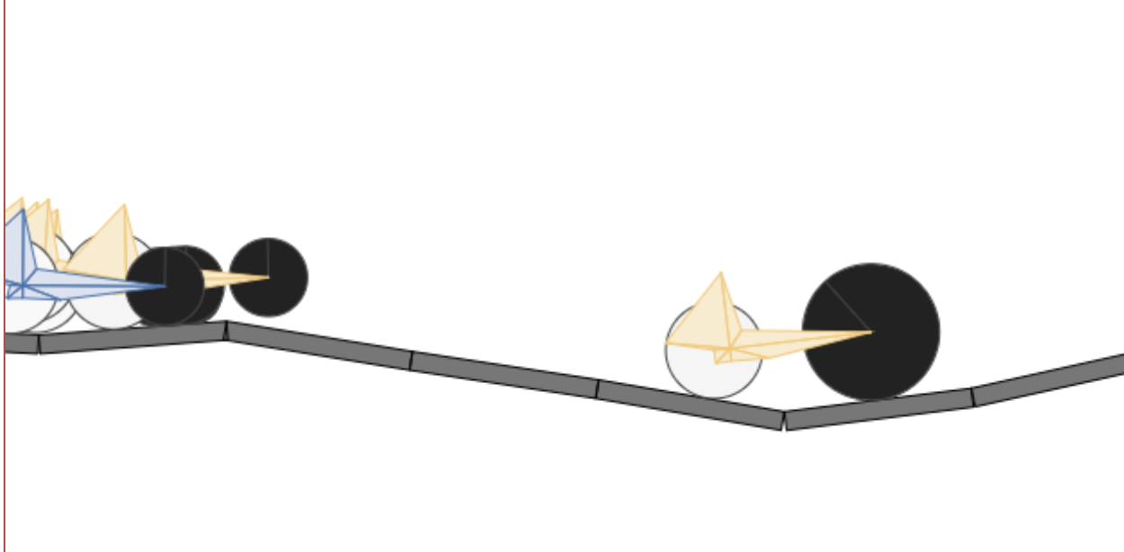
Mutation Size
Put you at 5%
Every car started to look the same
It wasn’t changing enough

Slide 7
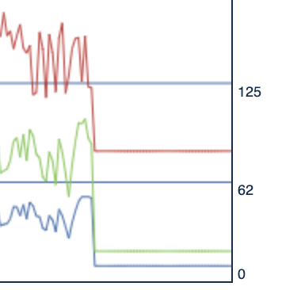
Mutation Rate w/ Mutation Size
Performance plummeted
The Elite Clone was the only car making it anywhere

Slide 8
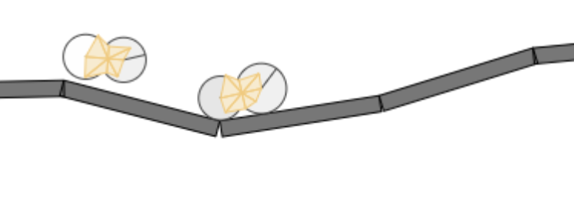
What if we got rid of the Elite Clone?
Reduce mutation size to 10% to compensate
What the heck is this?
I think that that one of these did well in an early expirement.
Everyone else copied and now we don’t get enough variation to change

Slide 9
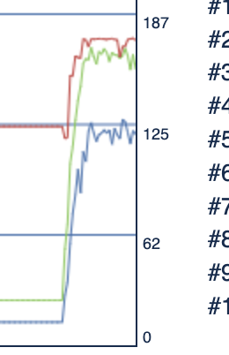
Let’s make 10 Elite clones
Mutation size back to 100% and Mutation Rate to 5%
Dang ok this is close

Slide 10
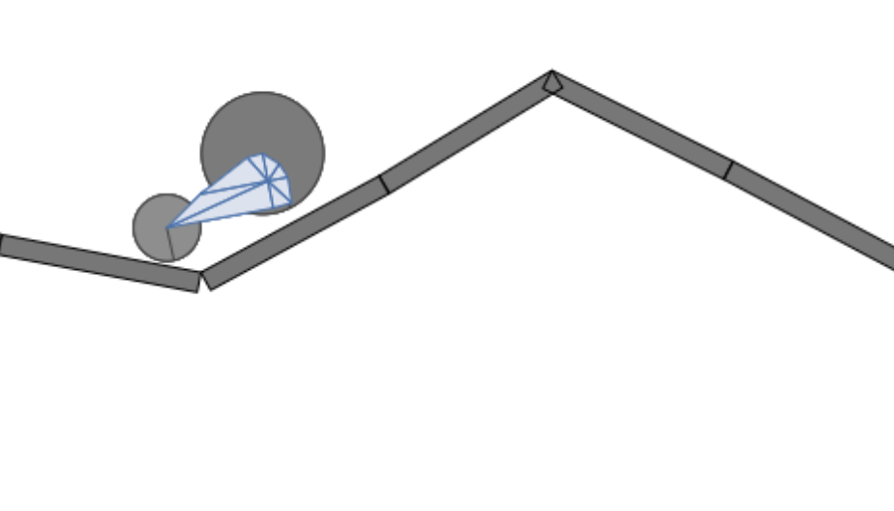
5 elite clones
Add some more variation

Slide 11
TL;DR
Turns out, my best car was in generation 16
The defaults work pretty well to get a car optimized
Hypothesis: Focusing on having more clones that you know will do well is probably the best way to get better cars.

Slide 12
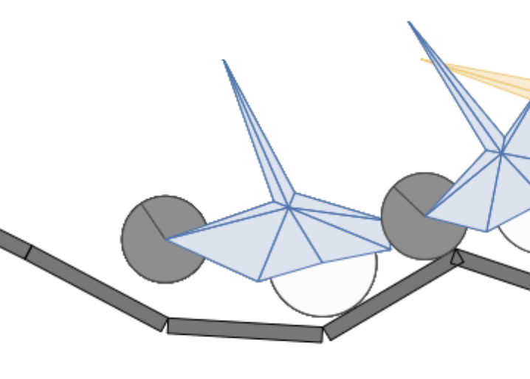
Let’s test this theory
Previous Best: 170 d
Elite clones maxed: 158 d
I think that having the opportunity to try things out in the beginning helped the population try things out until it was trying too many things.

Slide 13
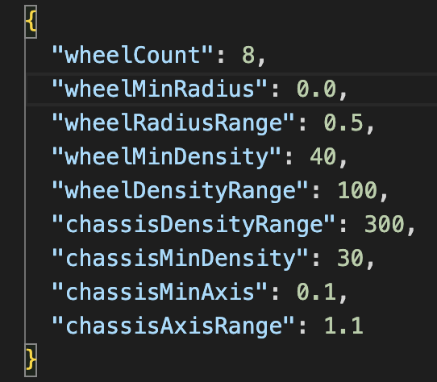
Mixing up the code
Src/car-schema/car-constants.json
What is the optimal amount of wheels?

Slide 14
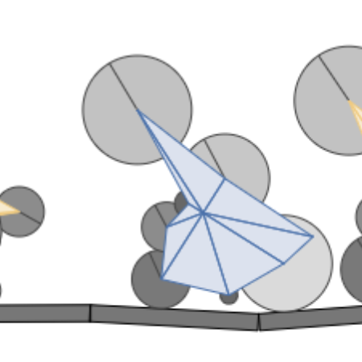
ANSWER: ~5
174 d

